Slide 1

Authentication Using Zero Knowledge Proof
Project Presentation
BY
MITU22BTCS0293 | GAURANG SHARMA
MITU22BTCS1037 | YOGESH THAKUR
MITU22BTCS0381 | KAUSHAL CHORDIYA
MITU22BTCS056 | PRADNYA KHORE
Guided By
Prof. Smita Gumaste
Department of Computer Science & Engineering, MITSoC, Loni Kalbhor

Slide 2
Index
1 INTRODUCTION
2 CONCEPTS AND METHODS
3 LITERATURE SURVEY
4 PROJECT PLAN
5. SOFTWARE REQUIREMENT SPECIFICATION
6 RESULTS
7 SOFTWARE TESTING
8 CONCLUSION AND FUTURE WORK
Department of Computer Science & Engineering, MITSoE, Loni Kalbhor

Slide 3
1. Introduction
Banking Sector in India is one of the major pillars behind the rapid economic growth of our Country and it is very important for this process to be efficient for saving time and resources of banks and users.
Due to some problems such as lack of resources and miscommunication between banks and customers this process is being affected.
Digitalisation of banking has played a major role in making the banking process easy but on the other hand for some users who are unable to operate these devices properly creates another problem that they have to face where they feel absence of proper assistance regarding the use of these online platforms
Department of Computer Science & Engineering, MITSoE, Loni Kalbhor

Slide 4
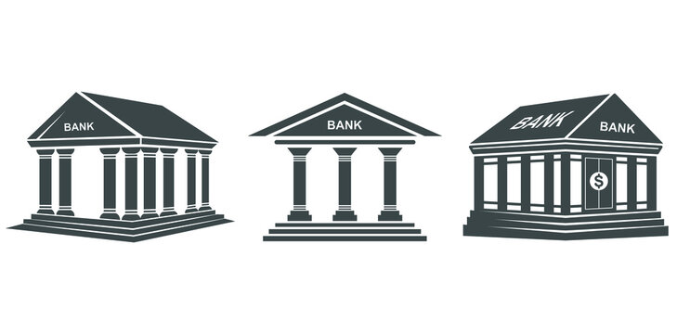
2. Problem Statement
Due to inefficient procedures and support provided by the bank causing
confusion among customers and waste of time of both bank and
customers
Domain – Banking
Technology – Python
Tools - Tkinter
Department of Computer Science & Engineering, MITSoE, Loni Kalbhor

Slide 5

3. Objectives
1
To provide the customers better knowledge regarding different procedures
2
To reduce time required for banking process
3
To provide a user friendly and interactive interface for better communication
Department of Computer Science & Engineering, MITSoE, Loni Kalbhor

Slide 6
4. Concepts and Methods
Surveys
Analysis of collected data
Planning of the technologies to be used
Product Features
Product Design
Department of Computer Science & Engineering, MITSoE, Loni Kalbhor

Slide 7
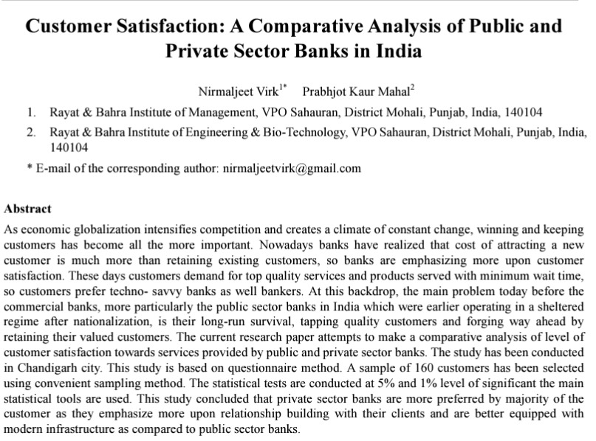
5. Literature Survey
From this research we understand that-
1. Banks prefer customer retention over new customer generation policies because retaining a customer is cheaper than generating new ones and banks generally run low on funds.
2. If the facilities at the branch ambience, infrastructure, working environment are adequate, it leads to better customer satisfaction .
Department of Computer Science & Engineering, MITSoE, Loni Kalbhor

Slide 8
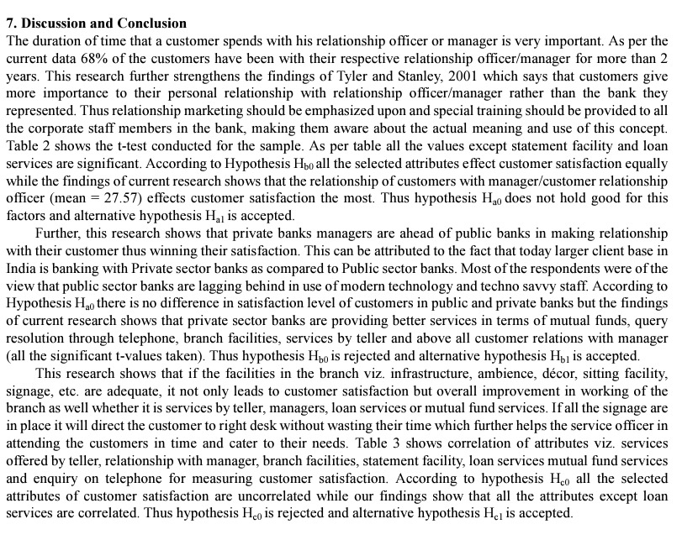
5. Literature Survey
From this research we understand that-
As per the current data, 68% of the customers, who have spent more time with the customer relationship management systems are found to be more satisfied with the results that the banks are providing compared to those who are not enrolled with any customer relationship management systems.
Department of Computer Science & Engineering, MITSoE, Loni Kalbhor

Slide 9
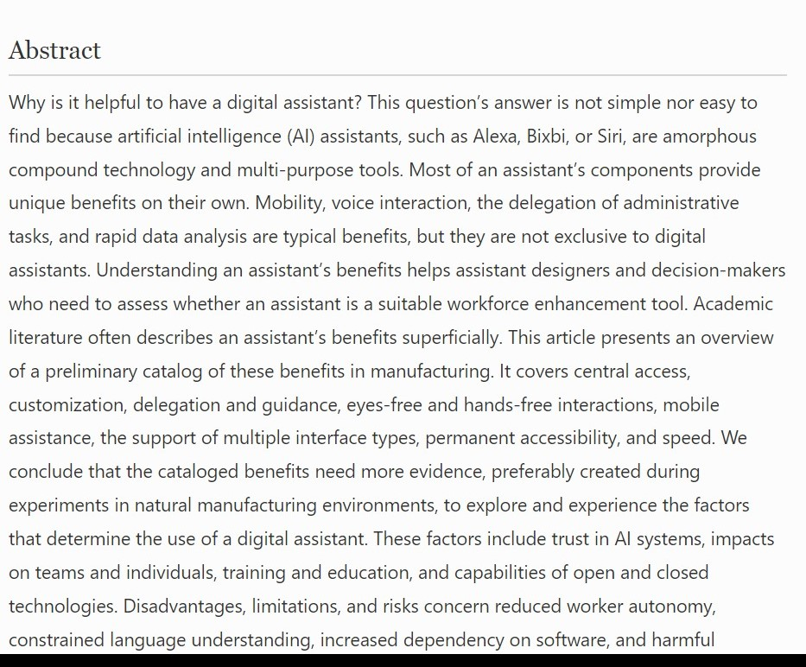
5. Literature Survey
From this research paper we can understand-
1. There is a need for assistants for banks such as Alexa, Siri, etc. which can interact with customers rather than just answer pre-defined questions
2. There are assistants established in banks but no special care has been taken to monitor how they function.
Department of Computer Science & Engineering, MITSoE, Loni Kalbhor

Slide 10




6. Tools and Languages
Python Programming language is used due to its features and modules
My SQL for data management as our project will include data management
Tkinter which is a python module for GUI Creation
To style the Tkinter widgets
Department of Computer Science & Engineering, MITSoE, Loni Kalbhor

Slide 11




7. Process and Architecture
PERSONAL EXPERIENCE WITH BANKS
RESEARCH ON THE PROBLEMS FACED BY THE CUSTOMERS
PLANNING THE SOLUTION AND PRODUCT DESIGN
CUSTOMER QUERY RESOLVING SYSTEM
Department of Computer Science & Engineering, MITSoE, Loni Kalbhor

Slide 12

8. Implementation
Department of Computer Science & Engineering, MITSoE, Loni Kalbhor

Slide 13
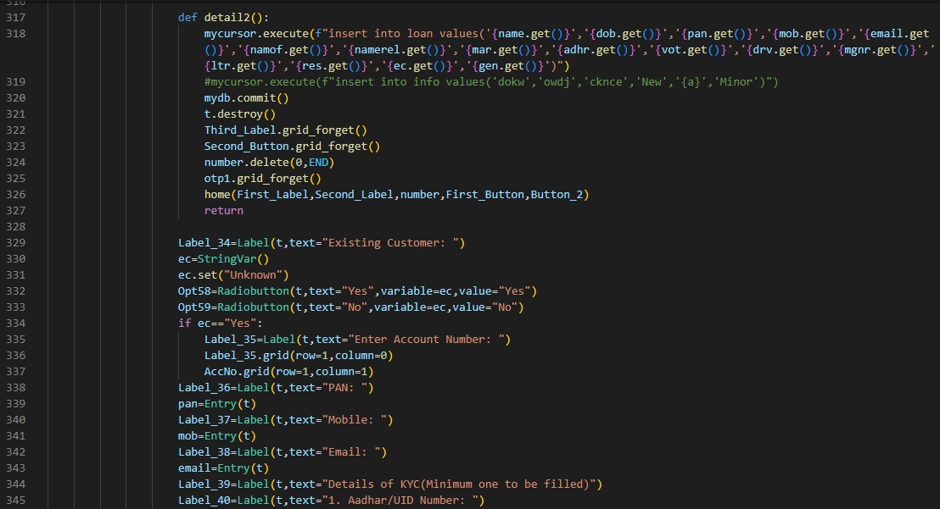
8. Implementation
Department of Computer Science & Engineering, MITSoE, Loni Kalbhor

Slide 14
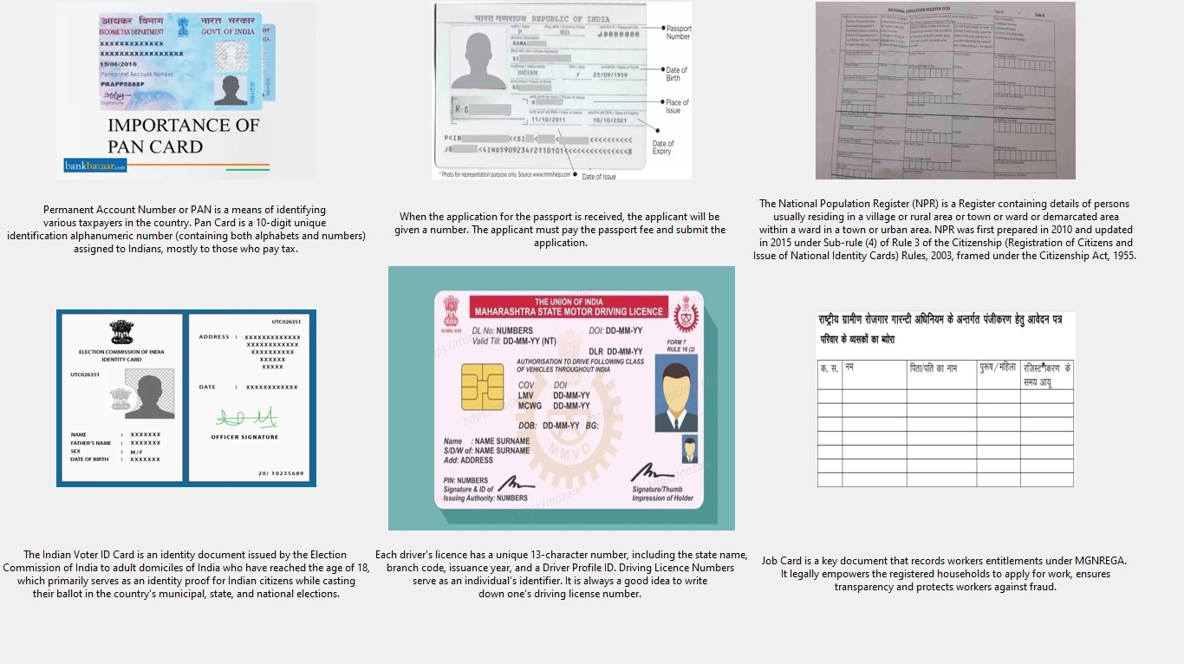
9. Results
Department of Computer Science & Engineering, MITSoE, Loni Kalbhor

Slide 15
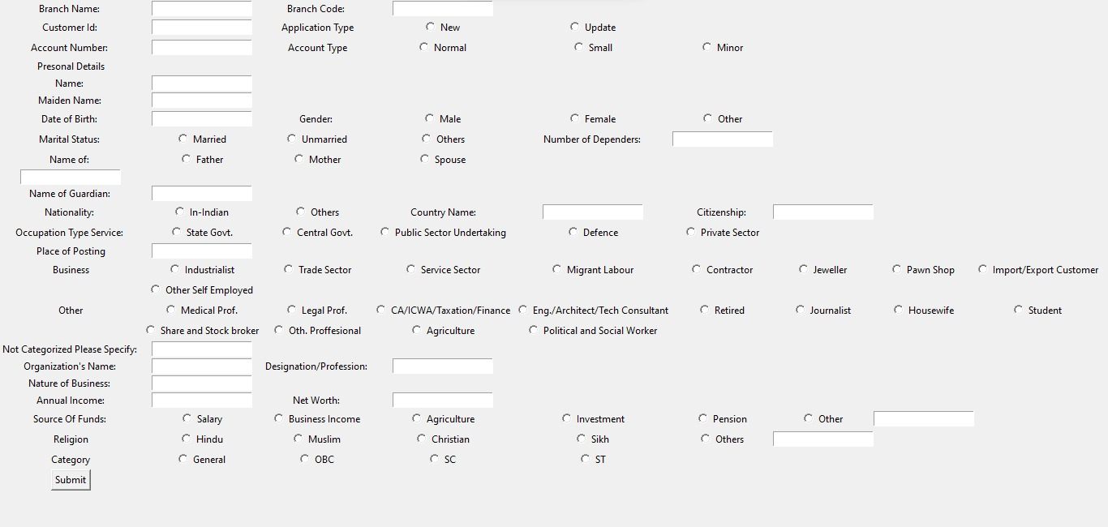
9. Results
Department of Computer Science & Engineering, MITSoE, Loni Kalbhor

Slide 16
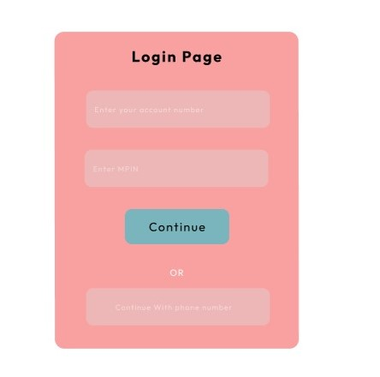
9. Results
Provide user Friendly Interface
Provide a checklist of documents required
Step by step process with images
Department of Computer Science & Engineering, MITSoE, Loni Kalbhor

Slide 17
10. Conclusion and Future Work
Conclusion –
After our research and interviews we came across these major problems
Imbalance between number of customers and bank employees
Time management of the customers
Lack of knowledge regarding banking processes
To solve the above problems we have created a guidance system for the bank customers which will guide them through different banking processes to save time and resources of banks and customers
Department of Computer Science & Engineering, MITSoE, Loni Kalbhor

Slide 18
10. Conclusion and Future Work
Future Work –
With the current working module these are some changes and improvements that we are planning to make
Introduce machine learning to increase number of uncommon questions
To create chatbot using AI for better assistance
We will train our model to scan different bank forms using AI
Department of Computer Science & Engineering, MITSoE, Loni Kalbhor

Slide 19
11. List of Publications
Customer satisfaction : A comparative analysis of public and private sector banks in India : Prabhjyot kaur Mahal
Conclusion of Customer satisfaction : A comparative analysis of public and private sector banks in India : Prabhjyot kaur Mahal
A study on Customer Satisfaction In Indian Retail Bank : Anubhav Anand Mishra
Banking Sector in India - Issues, Challenges and the Way Forward : PR India committee reports
Department of Computer Science & Engineering, MITSoE, Loni Kalbhor

Slide 20
References
https://herovired.com/learning-hub/blogs/indian-banking-sector-explained-challenges-opportunities-and-its-future/
https://prsindia.org/policy/report-summaries/banking-sector-in-india-issues-challenges-and-the-way-forward
https://www.economicsdiscussion.net/banks/nationalized-banks/9-major-problems-faced-by-indias-nationalized-banks/12927
https://economictimes.indiatimes.com/industry/banking/finance/banking/this-is-how-global-banking-crisis-can-impact-india-in-different-ways/articleshow/98862476.cms
Department of Computer Science & Engineering, MITSoE, Loni Kalbhor

Slide 21
References
[1] F. Jia and L. Z. Kong, “Intrusion Detection Algorithm Based on Convolutional Neural Network,” "Beijing Ligong Daxue Xuebao/Transaction Beijing Inst. Technol., vol. 37, no. 12, pp. 1271–1275, 2017, doi: 10.15918/j.tbit1001-0645.2017".12.011.
[2] L. Mohammadpour, T. C. Ling, C. S. Liew, and C. Y. Chong, “A Convolutional Neural Network for Network Intrusion Detection System,” "Proc. Asia-Pacific Adv. Netw., vol. 46, no. 0, pp. 50–55", 2018.
[3] U. Gur Çekmez et al., “Derin Ö˘ grenme ile A˘ g Anomali Tespiti Network Anomaly Detection with Deep Learning Ozgur Koray Sahingoz,” 2018, pp. 1–4.
[4] A. Chawla, B. Lee, S. Fallon, and P. Jacob, “Host Based Intrusion Detection System with Combined CNN/RNN Model,” "Lect. Notes Comput. Sci. (including Subser. Lect. Notes Artif. Intell. Lect. Notes Bioinformatics), vol. 11329 LNAI", pp. 149–158, 2019.
[5] S. Naseer and Y. Saleem, “Enhanced network intrusion detection using deep convolutional neural networks,” "KSII Trans. Internet Inf. Syst., vol. 12, no. 10, pp. 5159–5178, 2018, doi: 10.3837/tiis.2018".10.028.
Department of Computer Science & Engineering, MITSoE, Loni Kalbhor

Slide 22
Thank You
Department of Computer Science & Engineering, MITSoE, Loni Kalbhor

Slide 23
Questions
Department of Computer Science & Engineering, MITSoE, Loni Kalbhor

